Slide 1

Data Analysis on Magist for Enaic

Slide 2
Magist Overview
An online marketplace that offers products from almost all categories
Magist offers 32,951 products in 74 categories
Magist received 99,441 orders between 2016 and 2018.
Delivered 97% of the product to customer
Around 11 categories of products are technical products
Analysis made from 25 months of data.

Slide 3
TWO MAIN BUSINESS CONCERN
Is Magist a right platform to sell Enaic’s Technical Products ?
Does Magist offer fast delivery ?

Slide 4
Analysis made to decide if Magist is the right platform
Analysing Customer growth
Analysing Tech vs Non Tech Products sold
Analysing Tech vs Non Tech Customers
Analysing Tech vs Non Tech Sellers
Analysing Tech vs Non Tech Seller’s Monthly Income
Analysing Popularity of Tech products

Slide 5
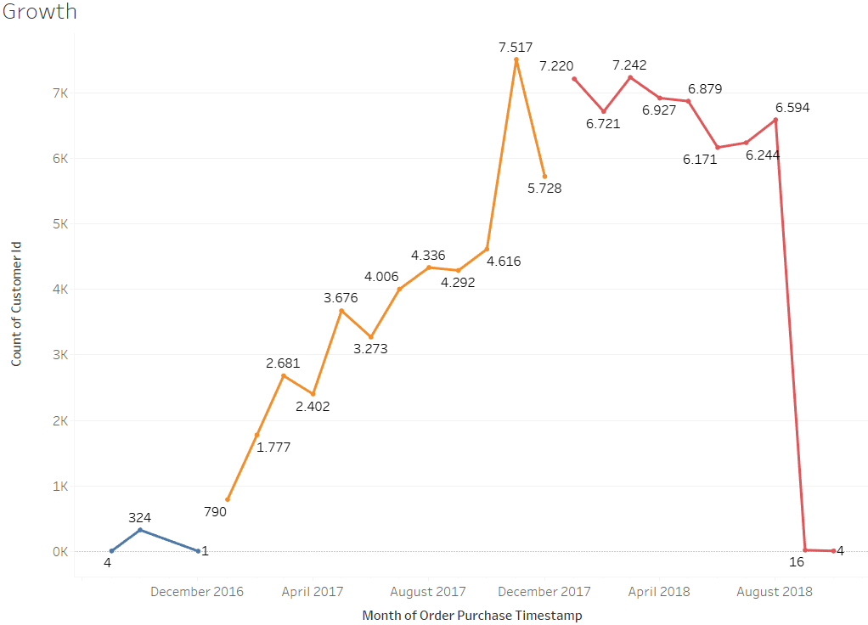

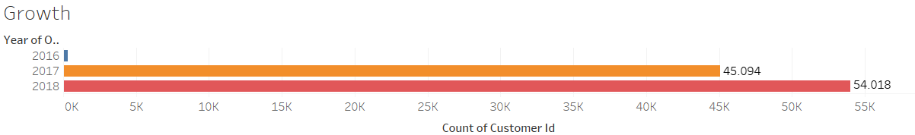
Growth 2016 - 2018
Magist had a good growth from 2016 but the growth started declining after 2018

Slide 6
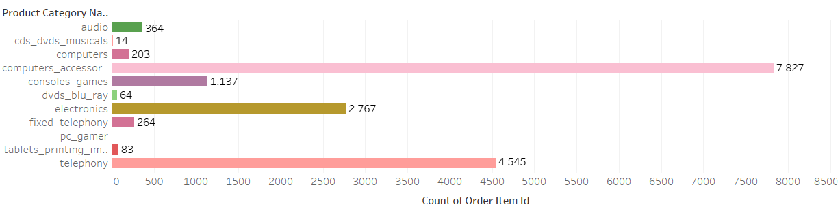
2.1 Tech Products Sold
No of Tech products sold - 17,277
Overall no of products sold - 99,441
% of Tech products sold - 17.4%

Slide 7
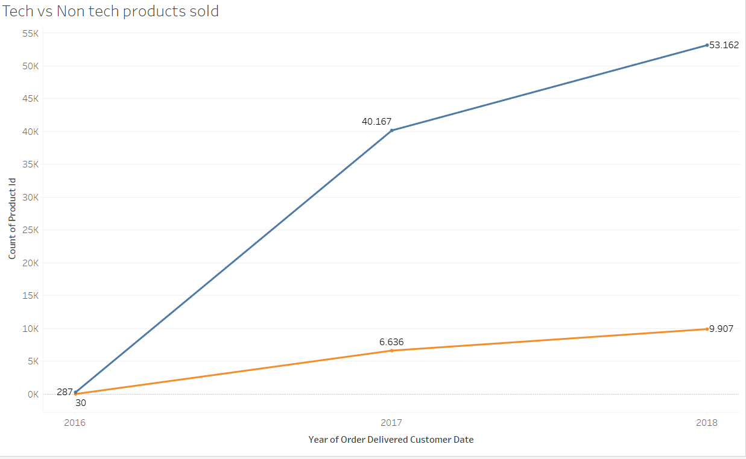

2.2 Tech vs Non Tech Products sold each year
Year | Non-Tech | Tech
2016 | 287 | 30
2017 | 40,167 | 6,636
2018 | 53,162 | 9,907

Slide 8
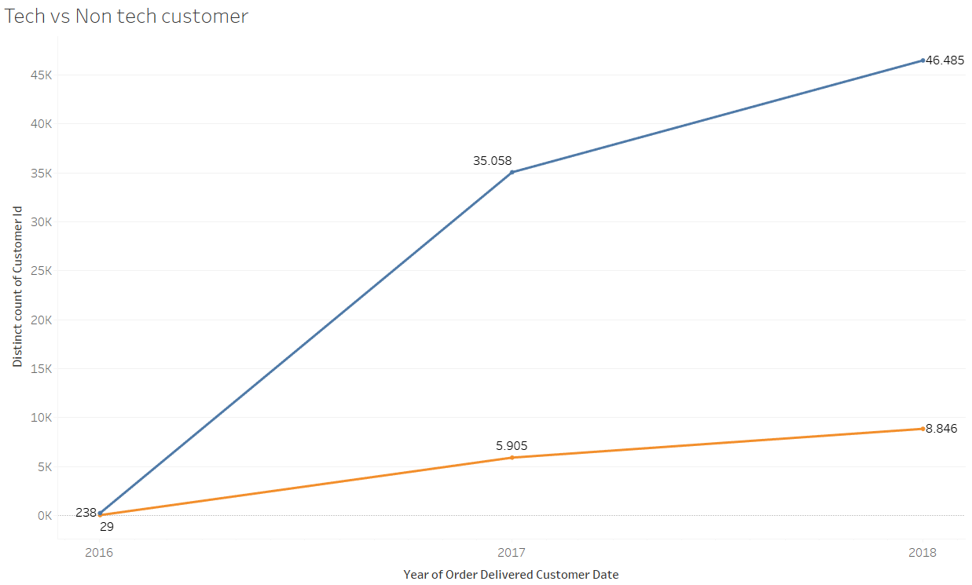
3. Customers who purchased Tech and Non-Tech Products each year
Year | Non-Tech | Tech
2016 | 238 | 29
2017 | 35,058 | 5,905
2018 | 46,485 | 8,846

Slide 9
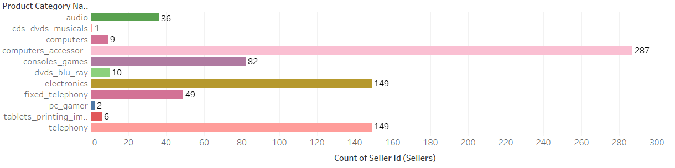
4. Tech Sellers
No of Tech seller - 492
Overall no of seller - 3095
% of Tech seller - 15.9 %

Slide 10
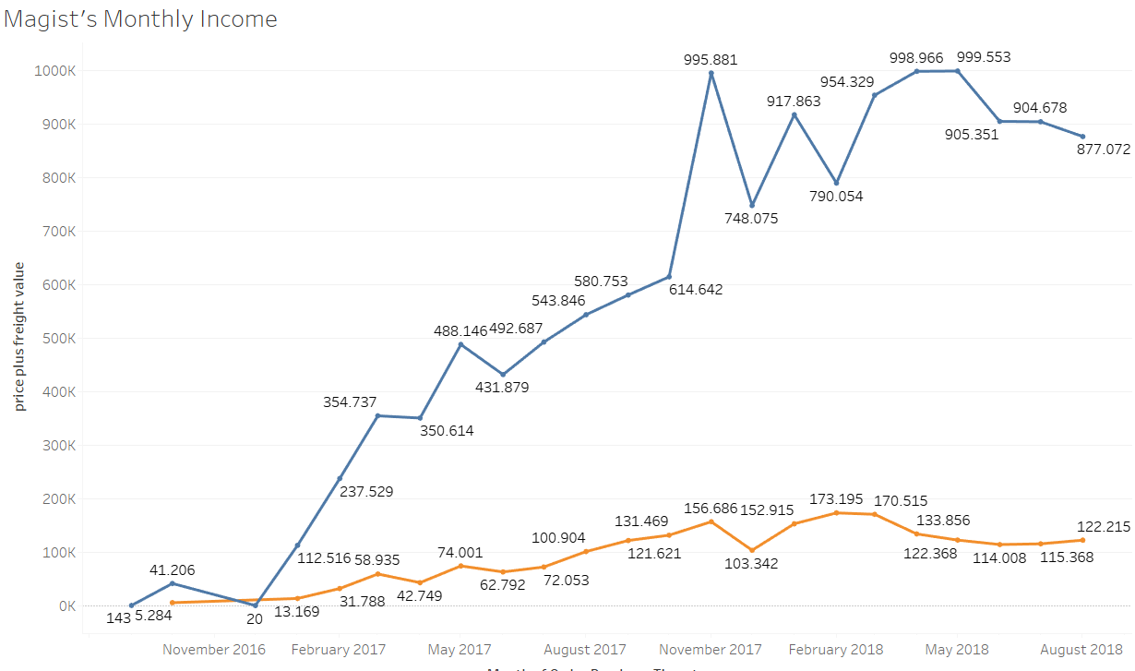
5. Tech vs Non Tech Sellers Monthly Income
Yearly income
Year | Non-Tech | Tech
2016 | 41,368 | 5284
2017 | 5.9M | 969,508
2018 | 7.3M | 1.1M

Slide 11
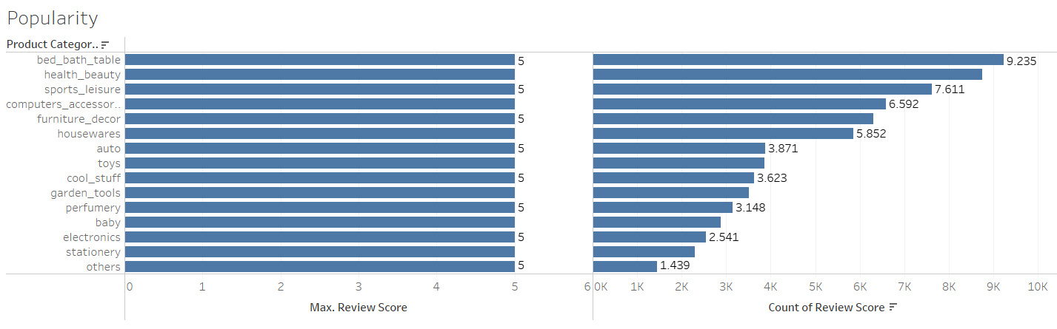
6. Popularity of Tech products among other products
-15 Top Products are chosen based on No of reviews and scores.
-Only 2 tech Products (Computer accessories and electronics) found.

Slide 12


Slide 13
Analysis made to decide if Magist provide fast delivery
Analysing Order status
Analysing Average Delivery time
No of orders Delivered on Time VS Not on Time

Slide 14
Order Status

Slide 15
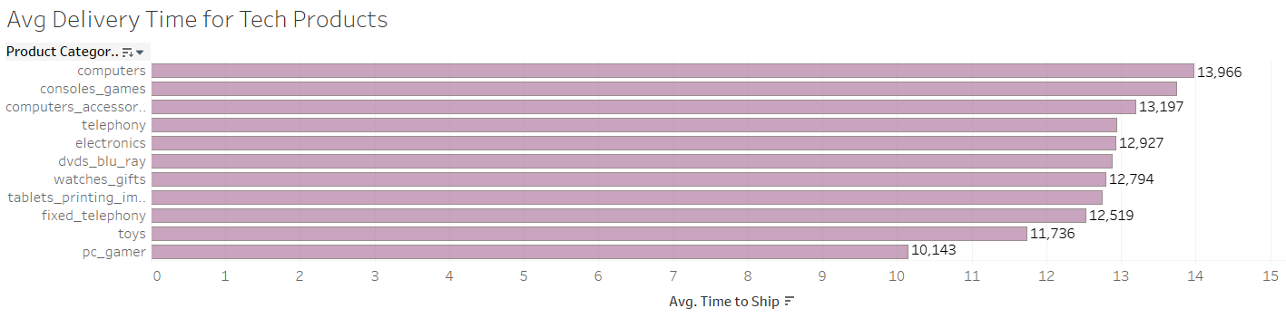
Average Delivery Time for Tech Products
Overall Average Delivery Time for all Products - 12.6 days
Overall Average Delivery Time for Tech Products - 12.8 days

Slide 16
No of orders Delivered and Not Delivered

Slide 17
Conclusion : Answering the business questions
Is Magist a right platform to sell technical products
Declining Customer growth
Limited no of tech products and tech Sellers
Tech products are less populous among non tech products
Low
Do they offer fast delivery
Long Delivery Time
Conclusion : Magist is a potential Marketplace for No tech products but since it lacks specilaization in Tech products and also has long delivery time , I would not recommend Enaic to sign a deal with Magist.
Magist made progress on delivering orders on time in two years but an average delivery period of 11 days is still a long time. Enaic is very well known for fast delivery. Delivery time over 5 -7 days are still considered a delay.
Conclusion : Magist is a potential marketplace for

